Slide 1


Slide 2

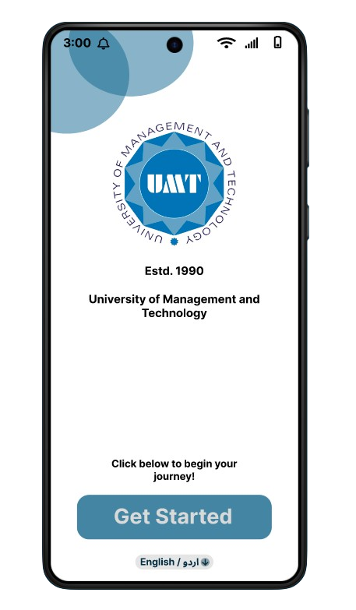

JAWA
Home
Photo
About Us
Contact
myUMT
App
The ultimate university companion for students to track progress, attendance, and stay updated with everything they need for academic success.
Explore Now
Play Video

Slide 3
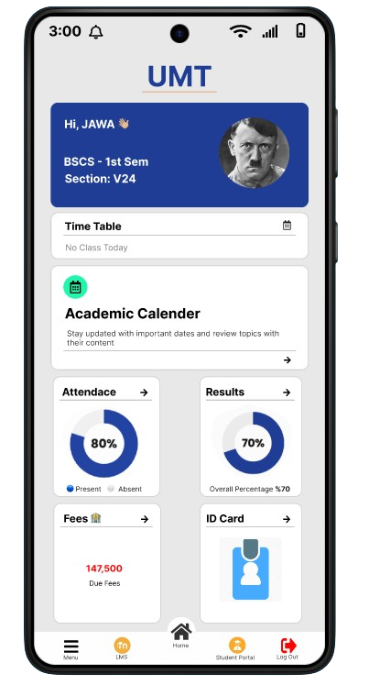
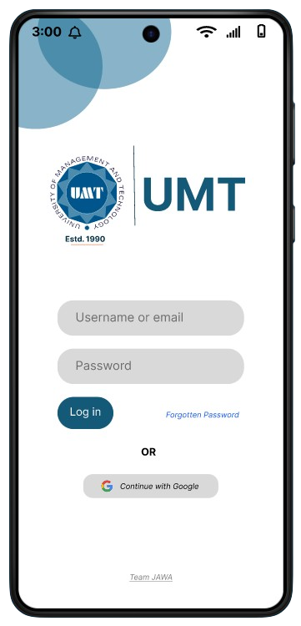
JAWA
Home
Photo
About Us
Contact
Welcome To Our Application
We’re excited to have you on board! This app is your go-to platform for managing your university life with ease. Track your attendance, monitor academic progress, and stay updated with the latest campus news and events—all in one convenient place. Explore and make the most of your UMT journey!
About Our Application
The UMT App is designed to enhance your university experience by providing easy access to essential academic information. From tracking your attendance and academic progress to staying updated with announcements and events, the app is your personalized gateway to everything at UMT. Our goal is to make your journey at UMT more organized, convenient, and engaging!

Slide 4
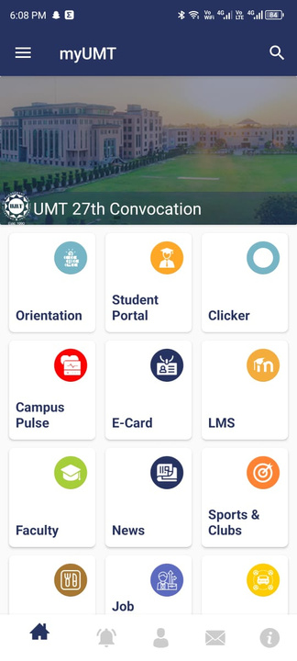
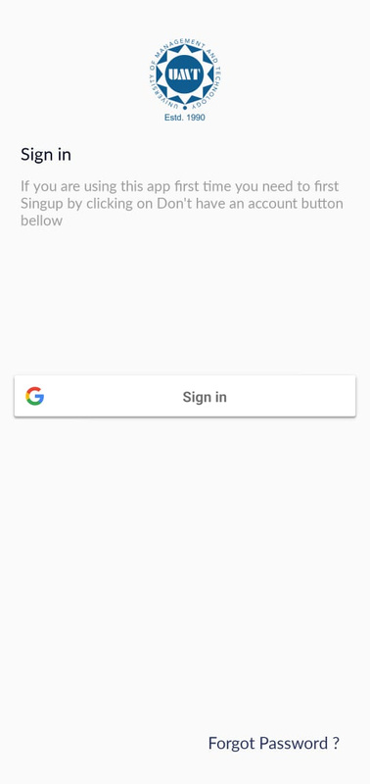
JAWA
Home
Photo
About Us
Contact
Disadvantage Of Old UI
01
The old UI lacks several features, such as support for multiple language options and a more visually appealing design.
02
The previous design lacked the use of emojis, which could assist semi-literate users in navigating and understanding the app more easily.
03
The old UI lacked a proper login page, which could lead to issues. It also did not include a basic username and password login section for user access.
04
The old UI was overly complicated, making it difficult to use. It lacked direct access to key features like the timetable, student progress, and other essential information.

Slide 5

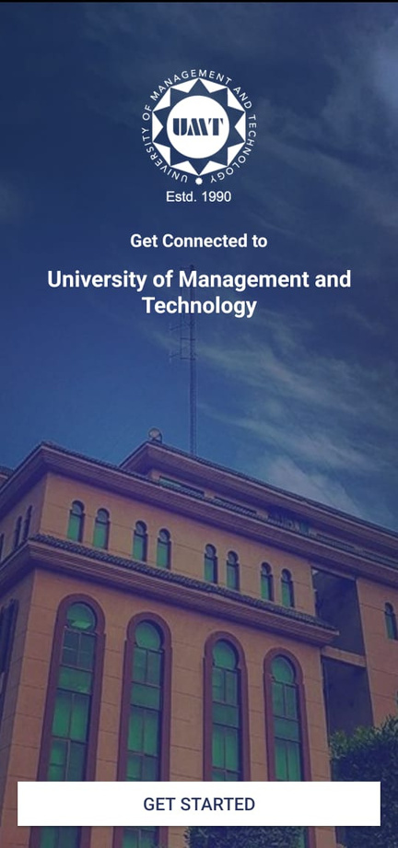
JAWA
Home
Photo
About Us
Contact
Old Vs New UI
Get Started Page
01
The new UI is simpler and easier to understand, while the old UI was boring and difficult to navigate.
02
You can now change the app's language by clicking the "English/Urdu" button, where a variety of languages are available.
03
The text "Click below to begin your journey" has been added, which wasn’t in the old UI. It changes with the selected language and helps semi-literate users identify which button to click.

Slide 6
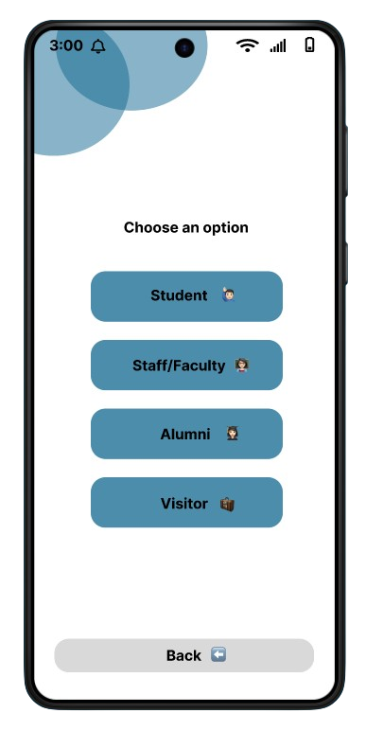
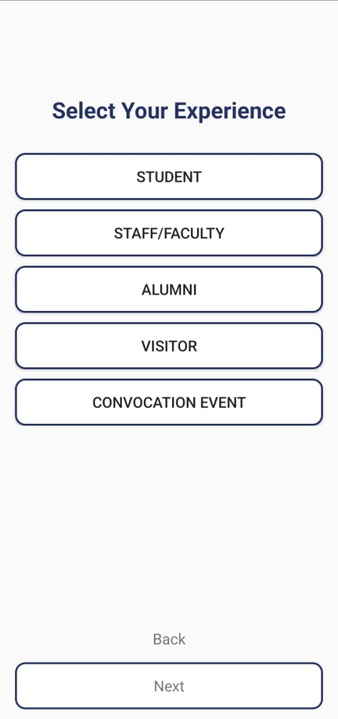
JAWA
Home
Photo
About Us
Contact
Old Vs New UI
Category Selection Page
01
The UI has been made more interesting by incorporating emojis, making it more attractive and user-friendly, especially for semi-literate users.
02
The "Next" button has been removed. Now, simply clicking on any of the available categories will take you directly to the login or home page.
03
The old UI was basic and lacked design elements. Numerous improvements have been made to transform it into a more user-friendly interface.

Slide 7

JAWA
Home
Photo
About Us
Contact
Old Vs New UI
Login Page
01
The login page has been upgraded with a sleek new UI, offering a smoother login experience and greater ease for new users.
02
There are now two ways to sign in: one by entering your username or email along with your password, and the other by using the "Continue with Google" option.
03
A "Forgot Password" option has been added, allowing users to easily reset their password if they forget it.

Slide 8

JAWA
Home
Photo
About Us
Contact
Old Vs New UI
Home Page
01
The UI has been redesigned and enhanced, providing direct access to important features and a more convenient logout option.
02
Students can now view the timetable and academic calendar directly from the homepage, eliminating the need to navigate to LMS.
03
Students can now directly access their attendance and results without the hassle of logging into the student portal and searching for them.

Slide 9
JAWA
Home
Photo
About Us
Contact
Home Page
Our intuitive menu interface ensures quick and seamless navigation. Users can easily access essential features like the timetable, academic calendar, attendance, and results, all designed for a smooth and efficient experience.
01
The Academic Calendar feature provides students with a comprehensive overview of important dates and events for the academic year
02
The Student Result feature allows students to access their academic performance and grades in a streamlined and transparent manner.

Slide 10
Studio Shodwe
Home
Photo
About Us
Contact
Thank You

Slide 11


JAWA
Home
Photo
About Us
Contact
About Us
Our Team
How We Got It Done
We are JAWA (Junaid, Abbas, Awais, Abdullah), first-semester BSCS students at UMT. Passionate about technology and innovation, we recently enhanced our university's user interface, aiming to improve the student experience
Our team used Figma to redesign and enhance the user interface of our university portal. With effective collaboration and dedication, we completed the project in a short timeframe.

Slide 12
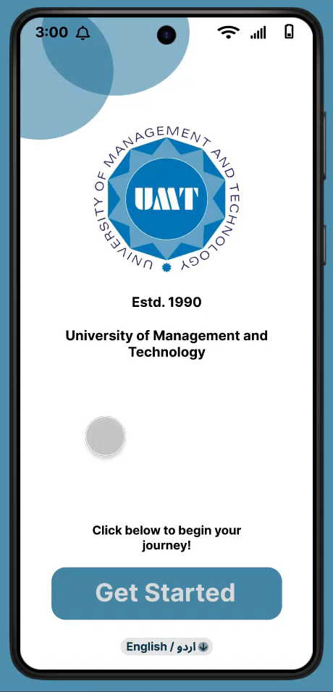




JAWA
Home
Photo
About Us
Contact
Contact Us
+92-334 0786565
https://shorturl.at/hjR2E
1172,1193,1170,1168@umt.edu.pk
UMT, Lahore, Pakistan

Slide 13
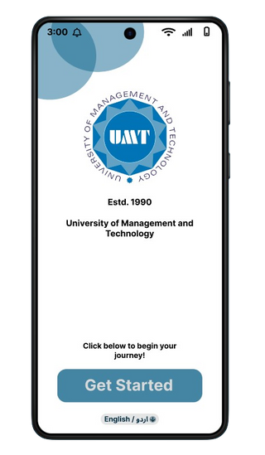


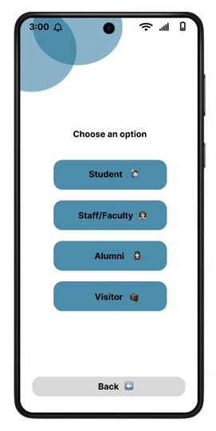
JAWA
Home
Photo
About Us
Contact
Photo Gallery
Check out our app gallery for a closer look at the features and design. Explore screenshots that highlight the app's interface and functionality!

